Slide 1
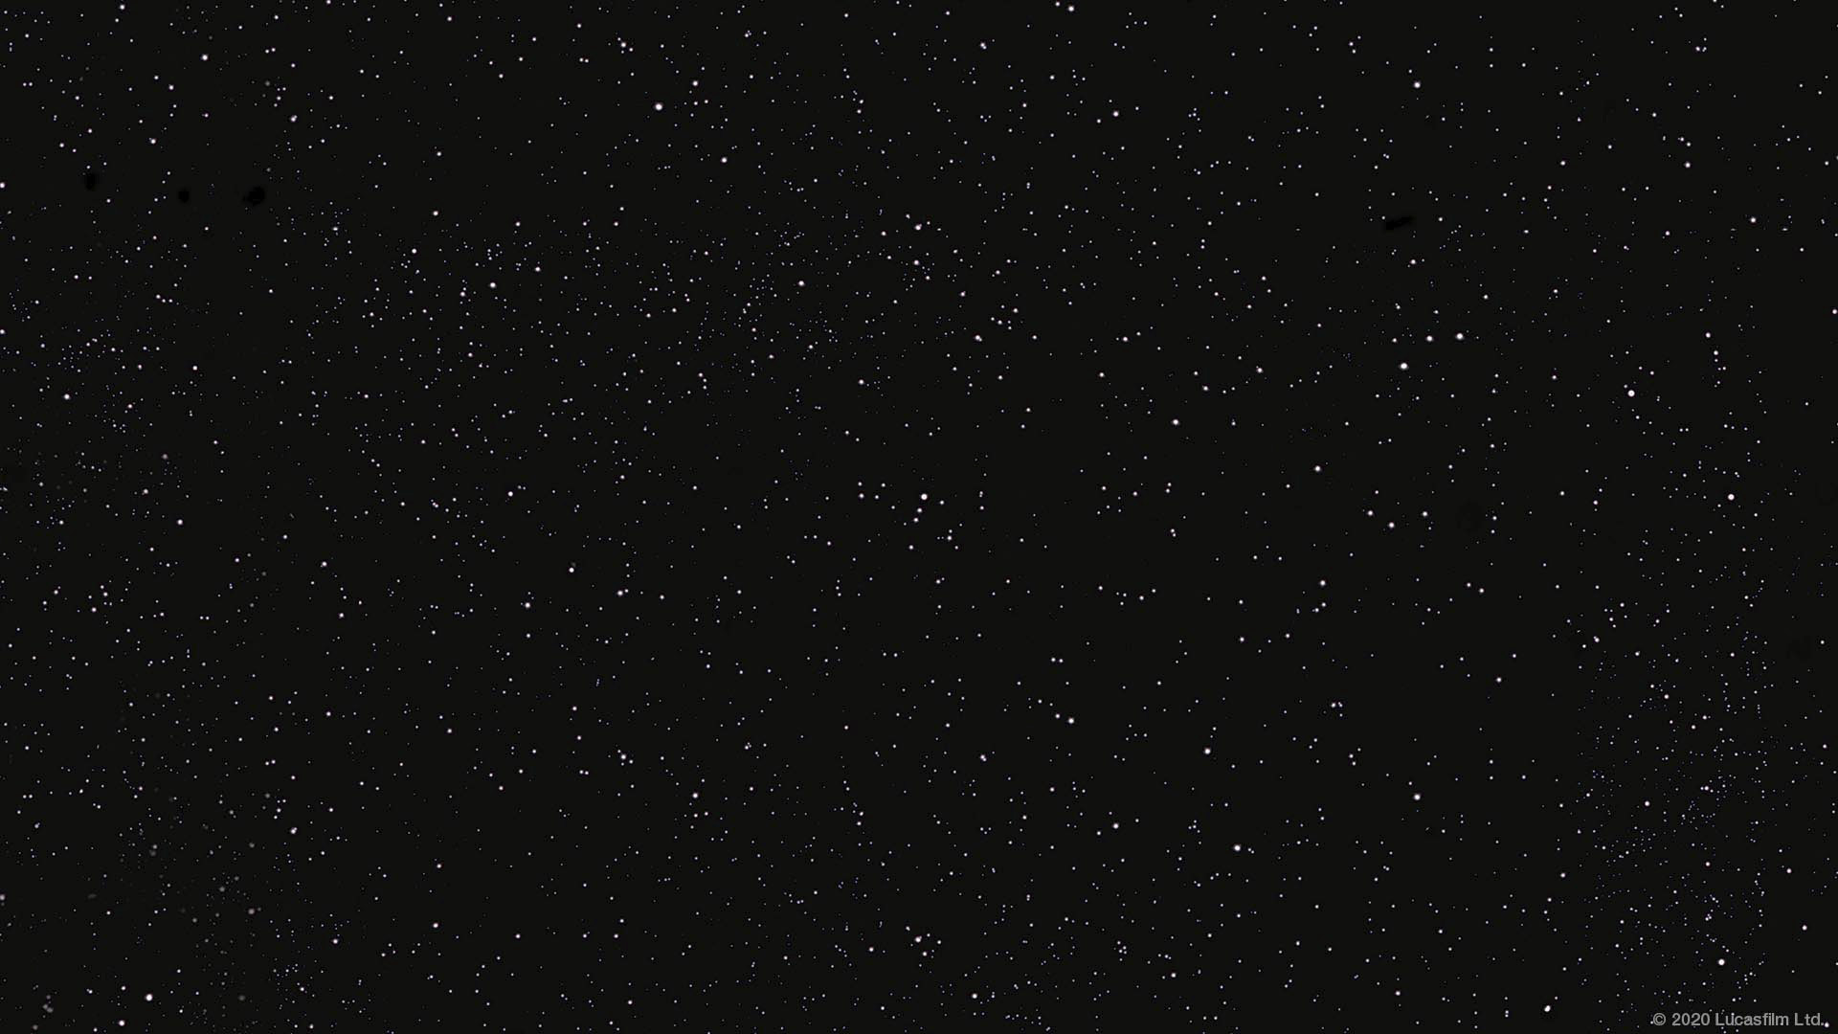
Group Seven Imperial Credit Predictions by: Savannah Jones, Megan Toale, Gabby Doty, Katie Bardwell

Slide 2
Data

Slide 3
Models

Slide 4
Predictions

